Slide 1
User Requirement Analysis
on
Edu-Right
180041203
Md. Sajid Altaf
180041204
Syed Mohammed Sartaj Ekram
180041219
Adham Arik Rahman

Slide 2
Methods of Collecting Data
Speculation
Questionnaire
Existing Systems

Slide 3
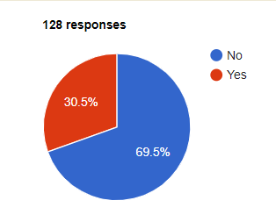
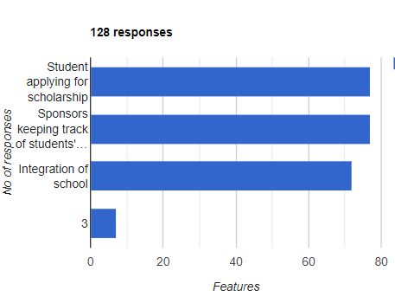
Feedback from Potential Users
Are you familiar with any scholarship providing Which feature(s) do you think can make a platform working to prevent students' dropout? difference if included in our system?

Slide 4
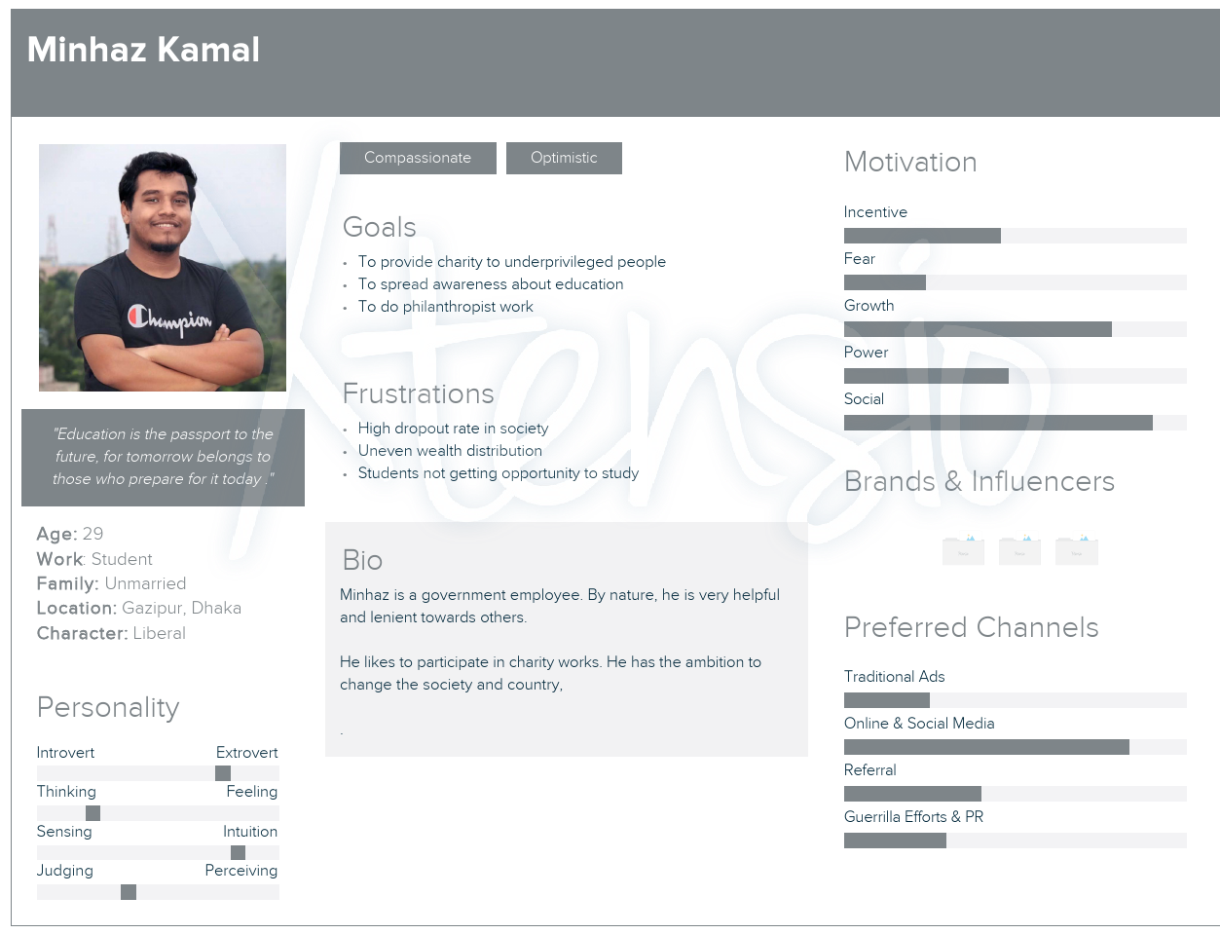
Persona 1

Slide 5
Scenario 1
Minhaz was going to a resort in Gazipur for a meeting. On his way his car broke down, luckily near a small workshop. So he went to there for help. Minhaz became very disheartened when he saw a boy aged around 10-12 was seen running around with heavy machineries on those very hands which should had books and pencils. How education has become a matter of privilege in our country,
“Hi little one, come here.”, Minhaz asked the boy, “Do you go to school?” “No sir my father is rickshaw puller and is very sick for some months and I am the eldest son. I have to work here part-time and I miss my school and studies.” This boy was really on the verge of dropout. Minhaz sighed thinking about the little boys future. Only a few more months then he would surely get dropped out of the school. Minhaz took out whatever he had in his pockets and gave to the boy. “Take this money and try to skip some days here whenever your exams or classes close in.” Minhaz knows very well within few weeks this money will run out and the boy will again come here for work and surely very soon will be a drop out like countless others.
If Minhaz had any system like ours, he could have helped more people like that boy in a more convineint and consistent way.

Slide 6
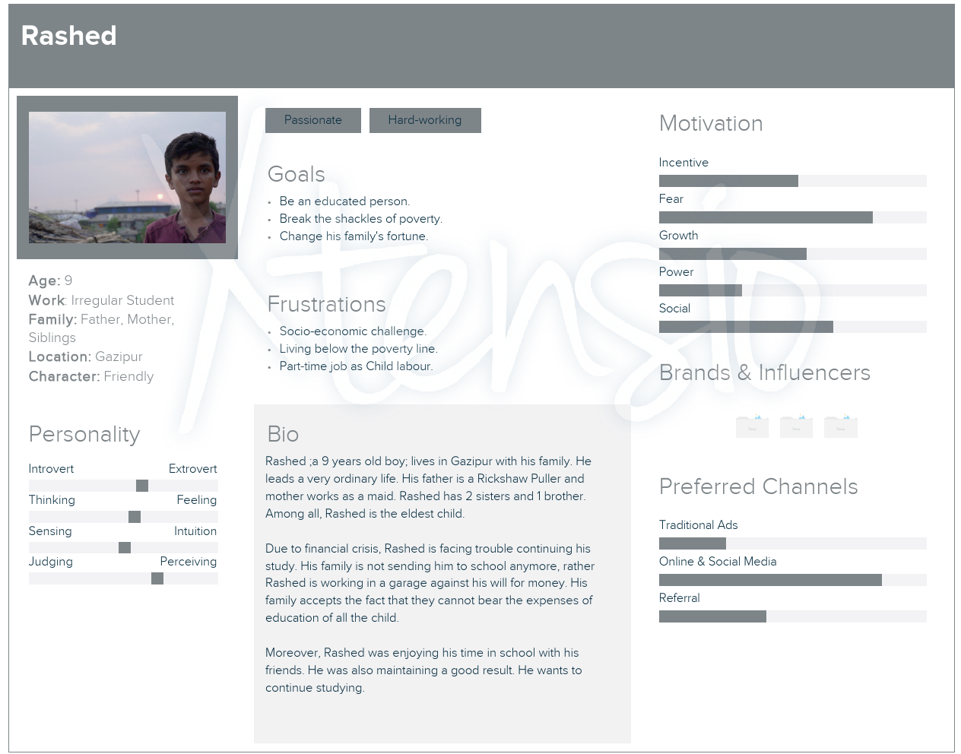
Persona 2

Slide 7
Scenario 2
Rashed is the eldest son in his family. His father pulls rickshaw for over 5 years to feed this family of 6. But for some months Rasheds father is very ill. Now they don’t even get two meals a day. Finding no other way, Rashed now has to work on a small workshop near the highway. Rashed is very calm and sensible even at this very young age. He is also a quick learner. The owner of the workshop really admires these traits of him and tells him to join full time. He also offers a higher pay for it. But rashid turned downed the offer for his studies. He is very good student and wants to become an automobile engineer. The teachers always praise his sincerity and seriousness. Even they show him as an example before the rest of the school. Shy little Rashed never boasts about all these to his friends. Even in the last exam he stood 3rd in his class. Rashid has dreams that keeps him wake even in nights. He studies late at night as he misses a lot of the studies because of doing part time work. But he won’t give up so easily. Rashed wants to pursue his dreams, wants to make shiny cars for this country and provide for his family in future. He wants to become the support that his family always lacked.

Slide 8
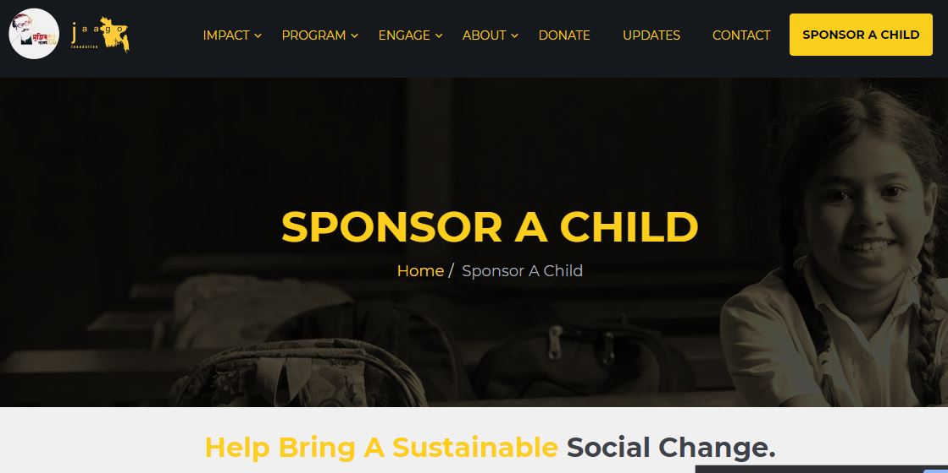
Example of Current Systems
JAAGO
Shapla Foundation
World Vision

Slide 9
Analysis of Current Systems
Available Features
Providing scholarship to underprivileged students
Verification of students
Transaction confirmation
Scope of Improvement
Students applying for scholarships
Integrating schools into the system
Tracking progress of students to maintain proper accountability

Slide 10
Requirements
# | Status | Features
1 | Must Have | Sponsors’ Profile, Students’ Profile, Verification of Students, Students applying for Scholarship
2 | Wish List | Integrating with School , Confirmation of transactions

Slide 11
Thank You

